Slide 1







Slide 2








Slide 3



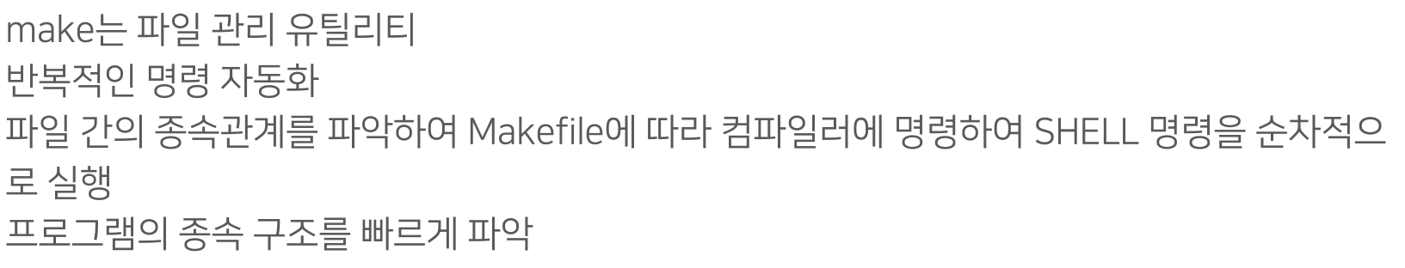

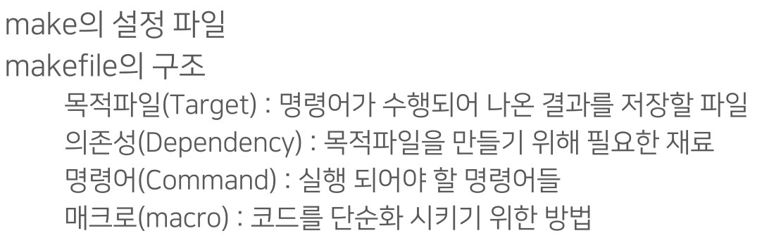


Slide 4


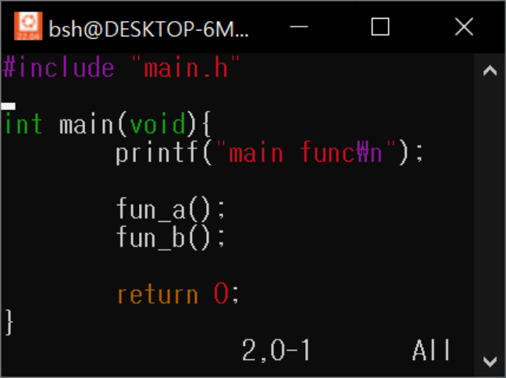


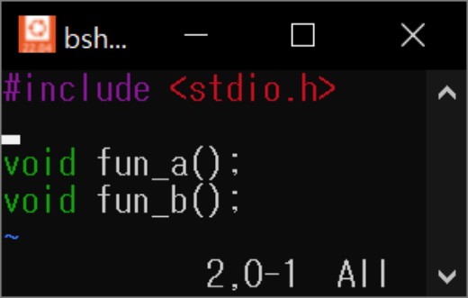


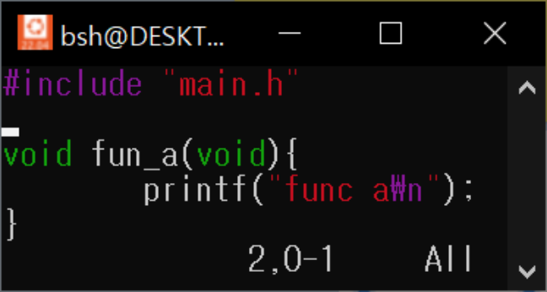



Slide 5


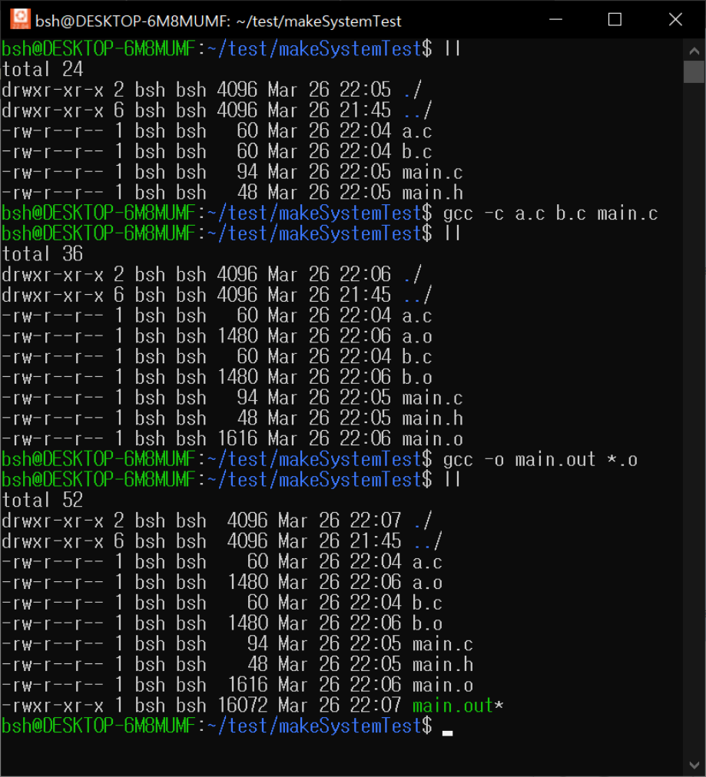








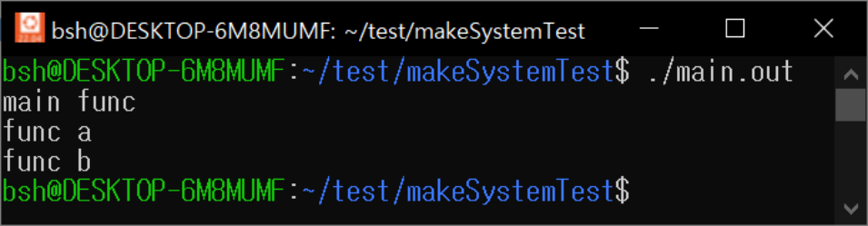


Slide 6



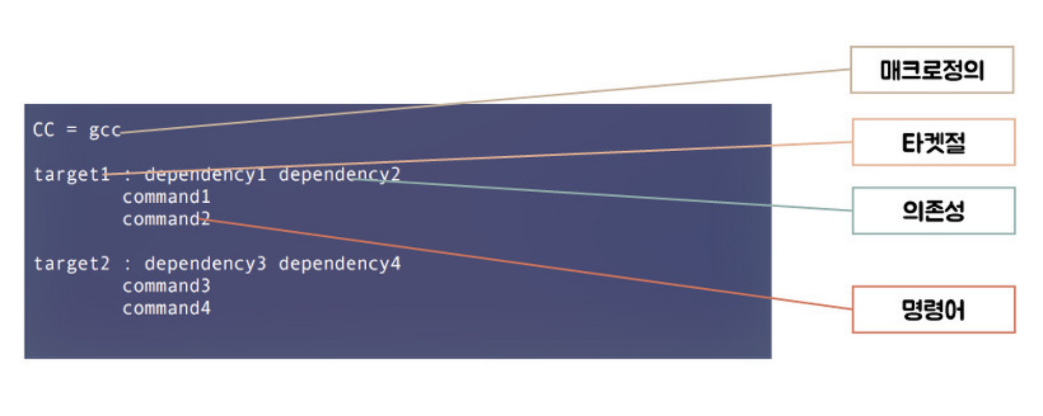
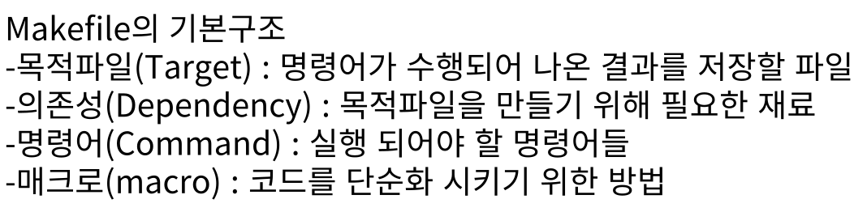


Slide 7
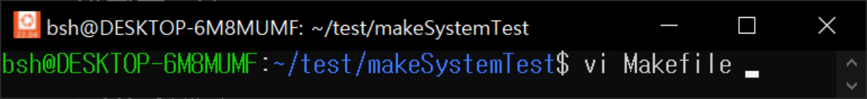
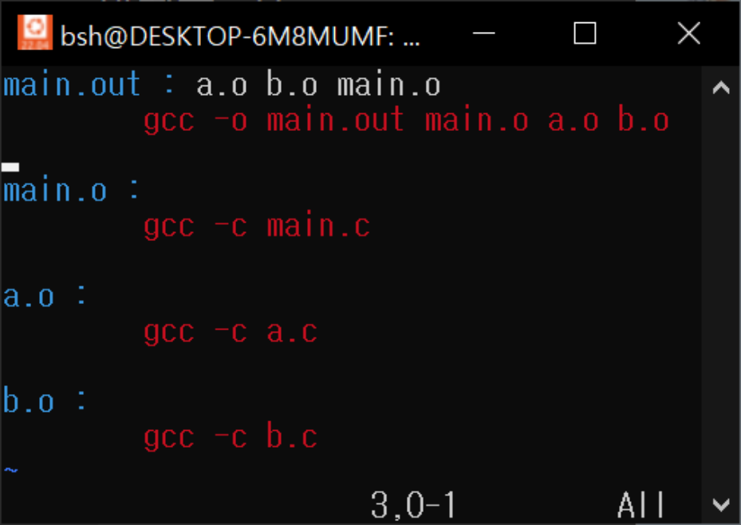
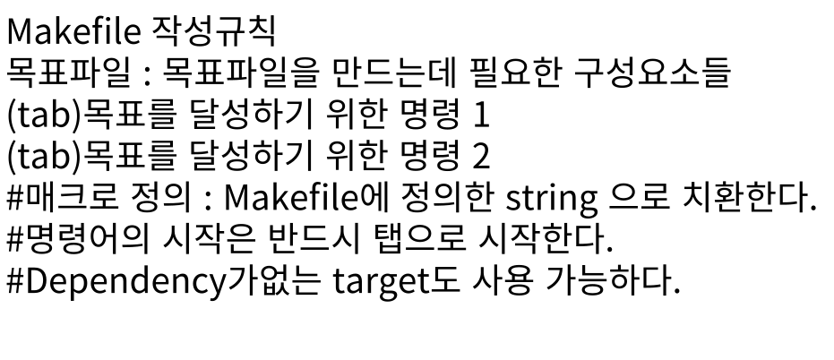


Slide 8
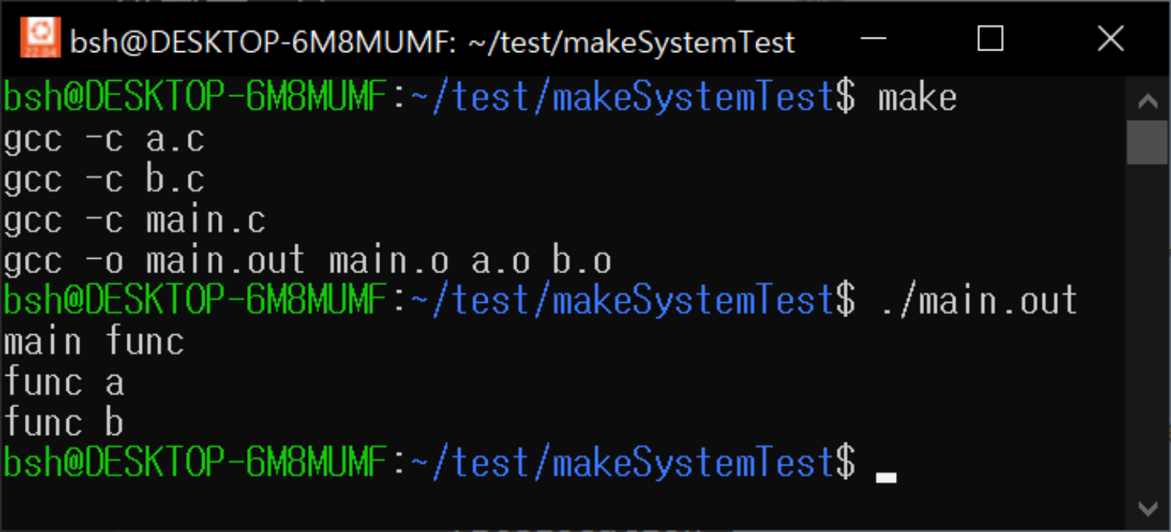


Slide 9
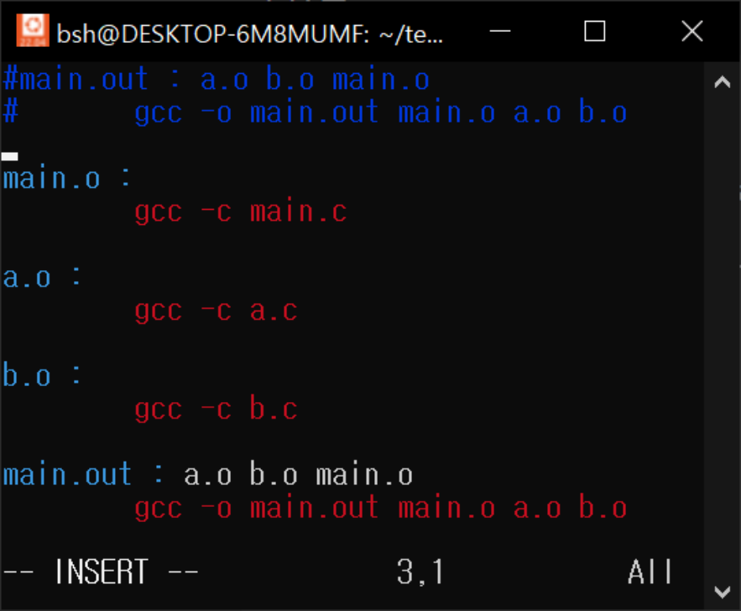
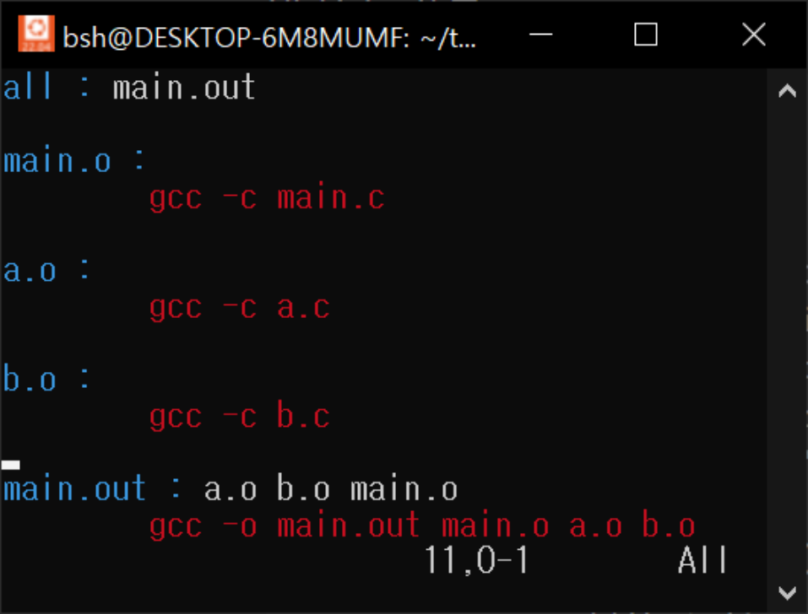



Slide 10


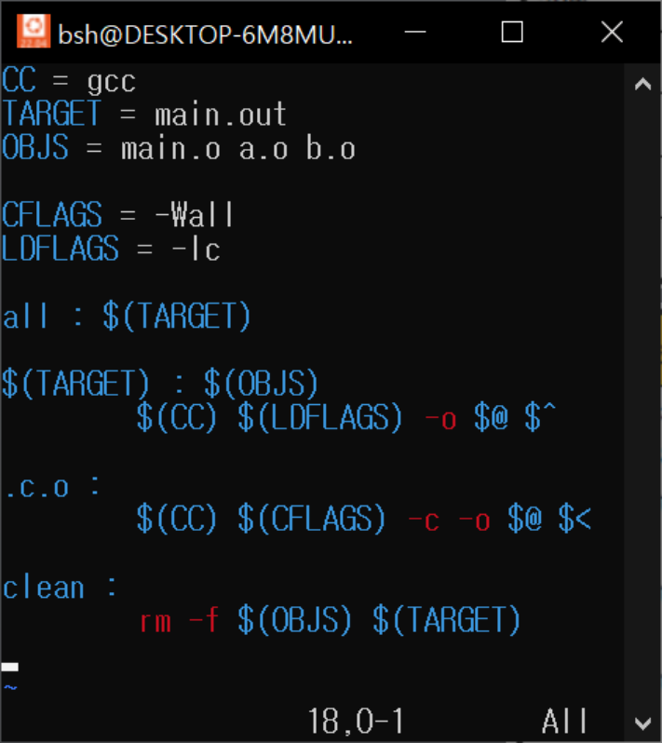





Slide 11


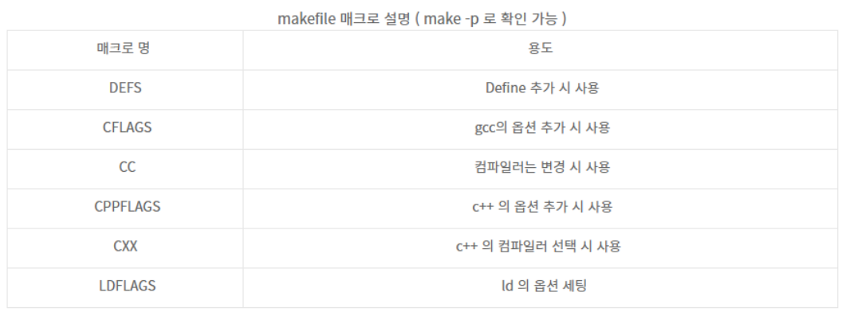
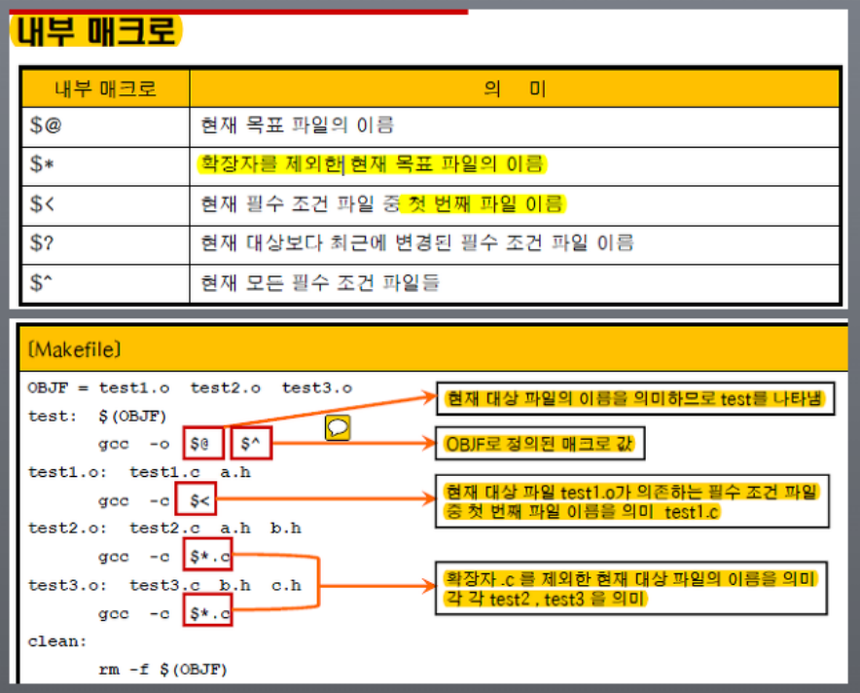



Slide 12


Make와 makefile: https://bowbowbow.tistory.com/12#make-%EC%99%80-makefile
https://www.youtube.com/watch?v=jnJL6ppn26Q&ab_channel=%EC%8B%9C%EA%B3%A8%EC%82%AC%EB%8A%94%EA%B0%9C%EB%B0%9C%EC%9E%90
Makefile의 매크로 종류1: https://yuns-helloworld.tistory.com/entry/GCC-compiler-%EB%82%B4%EB%B6%80-%EB%A7%A4%ED%81%AC%EB%A1%9C-Makefile
Makefile의 매크로 종류2: https://developer-wh.tistory.com/entry/make-%EB%8A%94-%EB%AC%B4%EC%97%87%EC%9D%B4%EB%A9%B0-%EC%99%9C-%EC%82%AC%EC%9A%A9%ED%95%98%EB%8A%94-%EA%B2%83%EC%9D%BC%EA%B9%8C1

